Slide 1

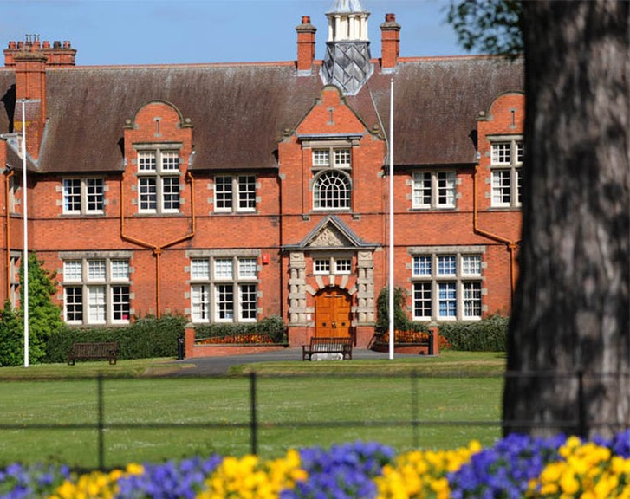


Financial Management
Your Students’ Union
Harpersu.com
Take a seat!
Notes:
Thank you for attending.
Introductions from everyone in the room? Name, position, and club/soc
You might be thinking why are we here?
Want to continue the work that Ian started
You are all really important to the SU, and the University
All want successful clubs and socs – mental health, retention, student experience.
First step into getting us working together
We need to, to protect you – finances, H&S. Also legally as a Charity
We can help you develop your groups – budgets etc – more on that later

Slide 2
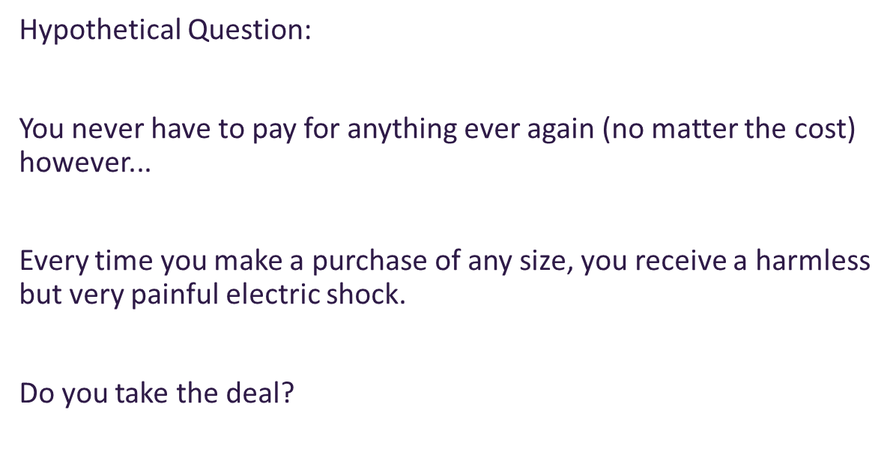
Ice breaker
Notes:
Introduce yourself to the person next to you, what are you doing, studying, preferred pronouns
Alternative Ice Breaker
To spice up the question; a puppy, your best friend, your partner, your nan etc
What’s the most important thing you’ve learned about money to date?

Slide 3

Welcome
Quick ground rules...
Notes:
Respect – challenge the statement not the person. Each person has their own experience to bring to this session so be respectful of that
Confidentiality - Information shared in the room stays in the room – feel safe to make mistakes!
Sensitive Issues – we may mention/discuss something that you find upsetting. If this happens do take a moment to compose yourself and return when you feel ready
There are no silly questions!

Slide 4
A bit of context…
HASU is a charity AND a Students Union which means…
Legal obligations
Charity Law
Education Act
In pairs:
What are some other laws that affect SU’s,
Clubs, and Societies?
Notes:
Freedom of Speech
Equality Act
GDPR
SafeGuarding
Health and Safety
Regulatory frameworks
Financial legislation and law
HE legislation

Slide 5

The Education Act 1994
Allocation of group funds
(i)the procedure for allocating resources to groups or clubs should be fair and should be set down in writing and freely accessible to all students;
Defines the meaning of SU’s
Part II 22 (i,) refers to resource allocation for groups and clubs
Part II 22 (j-l) refers to external affiliations
Notes:
Defines the meaning of a students’ Union. Particularly relevant sections are:

Slide 6
The Education Act 1994
The relevant parts for Activities:
What is a students' union?
How students are members (and how they opt out)
Allocation of resources to student groups
Affiliations and subscriptions to external groups/bodies
Notes:
Defines the meaning of a students’ Union. Particularly relevant sections are:

Slide 7

The Charities Act 2011
SU’s acceptable purposes is “the advancement of education of students”.
The objects of the union are advancement of education of students at [university name] for the public benefit by:
Promoting the interests and welfare at [Harper Adams] during their course of study and representing, supporting and advising students;
Being the recognised representative channel between students and [Harper adams] and any other external bodies; and
Providing social, cultural, sporting and recreational activities and forums for discussions and debate for the personal development of its students.
Notes:
Interests and welfare - can relate to student fundraising, as well as campaigns.
Social cultural and recreational activities - Clubs and socs, sports etc.
Forums for discussions and debate - AGM's, student media, debate clubs/society.
Voice - Represent
Support - All departments and staff
Advising - We do not have an advice centre like a lot of SU's.
Personal development - committee positions and training,

Slide 8
Relevance to Club and Society Finances
ULTRA VIRES
What does it mean?
A – Beyond the Powers
C – Education Only
B – Charity Embezzling
Notes:
Freedom of Speech
Equality Act
GDPR
SafeGuarding
Health and Safety
Regulatory frameworks
Financial legislation and law
HE legislation

Slide 9
Relevance to Club and Society Finances
ULTRA VIRES
What does it mean?
A – Beyond the Powers
C – Education Only
B – Charity Embezzling
Notes:
What does Ultra Vires mean?
Education only, Beyond the powers or ultimate virus?
As charities, student unions must take care to avoid Ultra Vires meaning "beyond the powers". A charity can't engage in activities that do not support their charitable purposes therefore beyond your powers as an organisation.
The purpose of student fundraising is the advancement of education (developing the students involved) It really is the taking part that counts! Some of the purpose also meets the interest and welfare of students while they study.

Slide 10
Ultra Vires
Clubs and societies are at a high risk of contravening UV...
All fundraising events should be organised by students for students.
Advance decisions with clear allocation of money.
Fundraising for other charities should clearly state the beneficiary (the targeted charity).
SU grant funding cannot be transferred to other charities.
SU’s and students shouldn’t underwrite RAG/fundraising losses.
Clubs and societies cannot use membership funds and leftover monies to donate to external charities.
We will go more in-depth in my next session: Planning Activities and Fundraising
Notes:
Education only, Beyond the powers or ultimate virus?
As charities, student unions must take care to avoid Ultra Vires meaning "beyond the powers". A charity can't engage in activities that do not support their charitable purposes.
The purpose of student fundraising is the advancement of education (developing the students involved) It really is the taking part that counts! Some of the purpose also meets the interest and welfare of students

Slide 11
How HASU Student Group Finances Work
Let’s get into how this is put into practice!
Notes:
Freedom of Speech
Equality Act
GDPR
SafeGuarding
Health and Safety
Regulatory frameworks
Financial legislation and law
HE legislation

Slide 12
Accessing Club/Soc Funds
NOT a bank account – you cannot withdraw funds or access them directly
Unique Nominal codes
We are cashless
Online Purchase Orders (PO’s) and Expense forms
Activities can buy items and charge to the society
You can buy items yourself and request reimbursement - Expense forms (up to £150)
Purchase Orders (coming up)
Please go through Activities first! We don’t want you out of pocket!
Notes:
Not like a current account – the union has one account from which all club and society transactions take place
Nominal code – the code we use to ensure money goes to the right place
Memberships, tickets and products all land in your account automatically, via the nominal code
Avoid taking cash but if you do, you can pay this directly into your account by going to finance

Slide 13
What you can buy…
Notes:
Freedom of Speech
Equality Act
GDPR
SafeGuarding
Health and Safety
Regulatory frameworks
Financial legislation and law
HE legislation

Slide 14
What can you buy?
Restrictions on where funds can be spent
Purchases need to benefit all members
What about the following items?
Money behind the bar for socials drinks?
Sunglasses for members?
Sports kits for 1st team?
Painting supplies for society activity?
Donating leftover income from a Dinner Dance?

Slide 15
What can you buy?
Money behind the bar for socials drinks?
No! Membership funds cannot be spent on alcohol. (See events/tickets below)
Sunglasses for members?
Yes! Benefits all members, just make sure you order enough.
Sports kits for 1st team?
It depends – do they have a different membership option which includes kit? Then yes. If everyone pays the same? No
Painting supplies for society activity?
Yes! It is general society equipment for all member activity.
Donating leftover income from a Dinner Dance?
No! This contravenes Charity Law and is ULTRA VIRES
^ However - there are steps you can take to make this legal.
Notes:
It is against HASU Policy to spend membership funds on alcohol.
The only time when clubs may purchase alcohol is when it is bottled alcohol at a ticketed event and has been paid for within a ticket. For example – a bottle of table wine included in a dinner dance ticket. This should be arranged via PO. Any expense forms that come through with “socials” on will not get approved by Activities and students will be out of pocket. And to be clear – this cost does not come from their membership money, it is separate income.
Sports kit – Be clear in your constitutions, budgets, and on the website what IS and IS NOT included in membership.

Slide 16
Alcohol
Society/Club funds cannot be used to purchase alcoholic drinks, except:
It is stated within a Sponsorship Agreement
Where alcoholic drinks are intrinsic to the nature of the Society/Club as defined within its Constitution (Cocktail Society, Brewing Society).
As part of a ticketed event.
Alcohol cannot be reimbursed if a receipt is submitted for a Dinner, only food can be if it is pre-approved.
Notes:
It is stated within a Sponsorship Agreement that a sponsor’s money can be used to fund social events or the provision of refreshments.
Where alcoholic drinks are intrinsic to the nature of the Society/Club as defined within its Constitution (Cocktail Society, Brewing Society). This can be in the form of cocktail making workshops, brewery tours etc. This is at the discretion of Activities and must include detailed justification.
As part of a ticketed event, in which alcohol spend is clarified in the event description, at the discretion of Student Activities. Please note that an event where alcohol is being sold must take place in a regulated and licensed premises.
Alcohol cannot be reimbursed if a receipt is submitted for a Dinner, only food can be if it is pre-approved.

Slide 17
Subsidising Event Costs
Funds can be used to subsidise members’ participation at the Society's/Club’s events – within reason!
Non-members cannot be subsidised.
Sports League fees, sports equipment and sports bookings can be funded for out of your Society funds, as long as all members have the chance to participate, and provided your group has sufficient funds.
Ticket costs for external events as well as internally-run events.
Must be detailed in annual constitution, budget, and website.
Must be detailed on event plan and event budget.
Society funds can be used for training for exec members for the benefit of the society.
Notes:
Funds can be used to subsidise members’ participation at the Society's/Club’s events, providing this is within reasonable levels and maintains a sensible level of retained funds to ensure the long term sustainability of the Society/Club. Funds cannot be used just for Exec members food/events. A budget and event should be approved before any money is spent.
Non-members cannot be subsidised.
Note for Societies (not sports clubs): Sports League fees, sports equipment and sports bookings can be funded for out of your Society funds, as long as all members have the chance to participate, and provided your Sociey has sufficient funds. Exec members must have approved this. Please note: Any Societies undertaking Sporting Activity are not covered for this under SU insurance. Sports kit must be paid for individually for Societies.
Smaller scale Club/Society events do not need a full event planning pack, but you should detail your event in an email to your coordinator before spending Club/Society money. Otherwise, reimbursement is not guaranteed.
Society funds can be used for training for exec members for the benefit of the society.

Slide 18
Clothing and Kit
Group funds may be spent on clothing and kit in certain circumstances:
Non-personalised clothing/kit that is owned and retained by the club/society – available to all members (not just team).
T-shirts, coats, hoodies, etc can be subsidised by fees as long as it is detailed in the membership, approved, and budgeted.
*Note that BUCS club kit and leisurewear must be ordered from Akuma as per our agreement with them.
Notes:
Club and Society Clothing
Non-personalised clothing/kit that is owned and retained by the club/society can be purchased using club/society funds. Note that this clothing must be available for use by all members. Any personalised kit or kit owned by individuals must be paid for by the individuals, not by club/society money.
Exec hoodies can be subsidised by a maximum of £25 per Exec member from your club/society funds, as long as this is approved by the Student Activities Team and your Club/Society has sufficient funds. You can either set up a shop to do this on the SU website, or get reimbursed. If you are getting reimbursed, you must ensure this has been approved by your coordinator beforehand.
**Note that club kit and leisurewear (for sports clubs) must be ordered from Akuma as per our agreement with them** See process here: Sports Kit (warwicksu.com)

Slide 19
How to spend it…
Notes:
Freedom of Speech
Equality Act
GDPR
SafeGuarding
Health and Safety
Regulatory frameworks
Financial legislation and law
HE legislation

Slide 20
Purchase Orders – how to:
Check you have the budget available – your spreadsheet.
Get approval from chair and/or Treasurer.
Get a quote from the supplier.
Ask Treasurer/Chair to complete a Purchase order form using the quote (On SU website) https://www.harpersu.com/getinvolved/onlineforms/
PO should be approved within 1 week – you will receive an email with approval which contains the PO number at the top of the form.
Provide the supplier the PO number and ask them to put it on their invoice.
Send invoices to suactivities@harper-adams.ac.uk and copy in HASUaccounts@harper-adams.ac.uk
Maisie is the budget holder, she will check your budget and verify with Chair/Treasurer and approve it.
Finance will match the PO to the Invoice and make payment.

Slide 21
Asking for the credit card
Monthly limit on HASU Credit Card – only ask for it if it is a big expense and you definitely cannot use invoices (ask the supplier/company if they have a business customer system you can use).

Slide 22
Spending money/claiming back
Identify expenditure type:
BUCS and associated costs.
Kit and equipment.
Refs, umpires and coaches.
Non-BUCS events and other competitions.
Stash and other merch.
Dinners and events.
Trips.
Donations to other charities.

Slide 23
Expense Form vs PO Form
Expense Form:
Small purchases – tea bags etc.
<£150 overall.
Checked with Treasurer/Chair it’s okay.
Keep VAT Receipt and make sure it is attached.
Purchase made to be repaid.
In-person expenses at shops.
Reimbursed directly to student.
Any member can submit.
Money approved AFTER purchase
Submitted by person who spent the money.
Approved by Chair/Treasurer then Activities before reimbursed
Purchase Order Form:
Bigger purchases, affiliation fees, fines, external tickets etc.
Bulk orders of kit, merchandise, equipment etc.
Attach quotes and forward invoices to finance after.
Anything associated with tickets or products sold by groups.
Transport bookings
Treasurer or Chair submissions only
Money approved BEFORE purchase
Event supplies:
Catering and Wine
DJs
Venue Hire
Approved by Activities, PO number sent to supplier, finance pay invoice after goods received.

Slide 24
Expense Form vs PO Form
Still unsure?
Submit a PO first so you aren’t put out if your group doesn’t approve it or have the money!

Slide 25
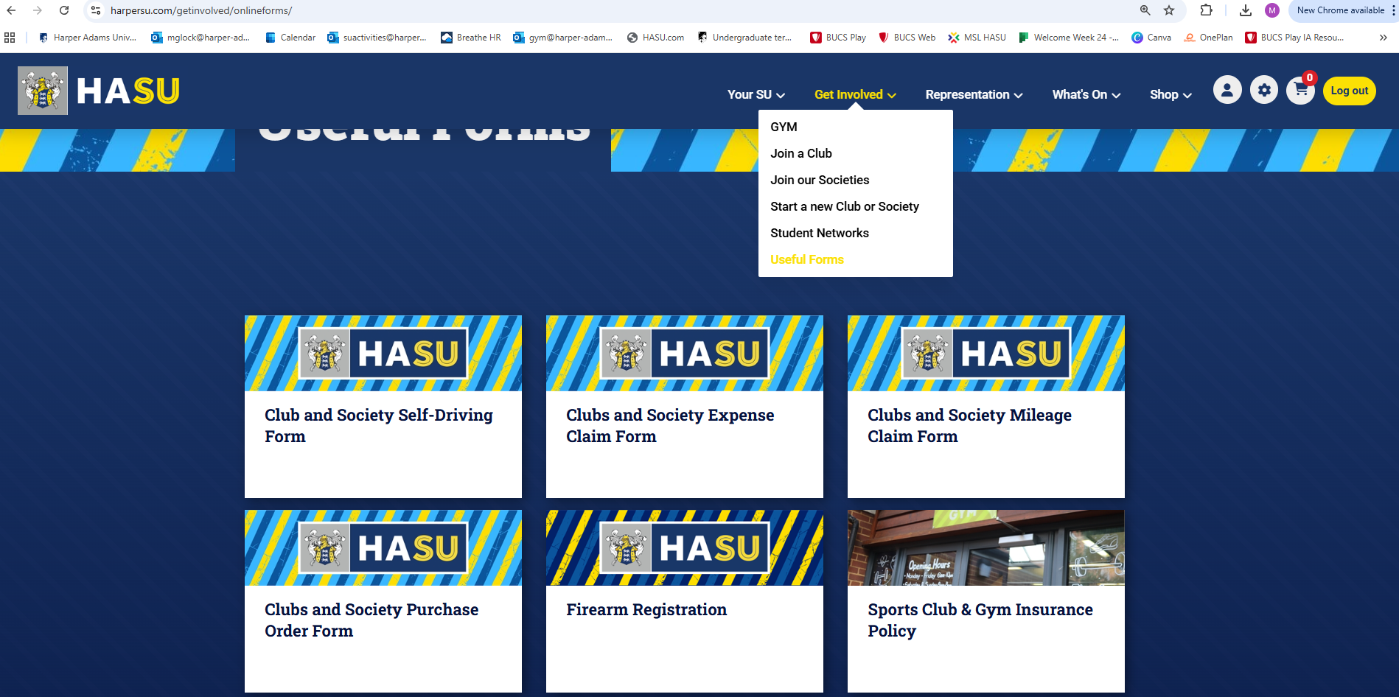
Where to find the forms
Notes:
You can find our online Expense and PO forms on the website under Get Involved – Useful Forms

Slide 26
Your role in it all…
Notes:
Freedom of Speech
Equality Act
GDPR
SafeGuarding
Health and Safety
Regulatory frameworks
Financial legislation and law
HE legislation

Slide 27
What does a treasurer do?
1.Record monies received
2.Pay monies into club or society account promptly
3.Record Income and Expenditure separately
4.Keep accurate records
5.Keep your committee informed about financial matters
6.Create a budget for your club/society for the year
7.Approve club/society expenditure
8.Liaise with the Student Union about what’s in your account
9.Complete financial forms e.g. invoices and purchase orders (POs).
10. Ensure spending is pre-approved and within the rules of student group accounts.
Notes:
3. You shouldn’t mix income and expenditure (i.e. keep cash in and cash out separate).
4. It often helps to keep a petty cash float for very minor purchases. Set a reasonably small amount that gets topped up to that level on a fixed date each month. Keep a “petty cash” book to record monies removed, and store receipts.

Slide 28

What does a treasurer do?
Maintain a register of assets/equipment
Carry out some online transactions
Ensure policy compliance.
Track spending against Budget.
Apply for additional funding such as grants
Approve PO’S and Expenditures weekly
Process Sponsorships and Donations
Notes:
Keep the SU updated with assets so we can update asset register.

Slide 29
Supporting your Treasurer
Review their budget and stick to it!
Check any expected spending with them before you do it.
Let them know in advance about any additional or unexpected costs.
BUCS – let them know about any fines or other expenses that will be due at the end of the year.
Always attach receipts to expense forms.
Write expense forms and POs (Chairs) clearly for smoother approval.
Submit expenses timely – within 30 days of purchase!
Notes:
3. You shouldn’t mix income and expenditure (i.e. keep cash in and cash out separate).
4. It often helps to keep a petty cash float for very minor purchases. Set a reasonably small amount that gets topped up to that level on a fixed date each month. Keep a “petty cash” book to record monies removed, and store receipts.

Slide 30
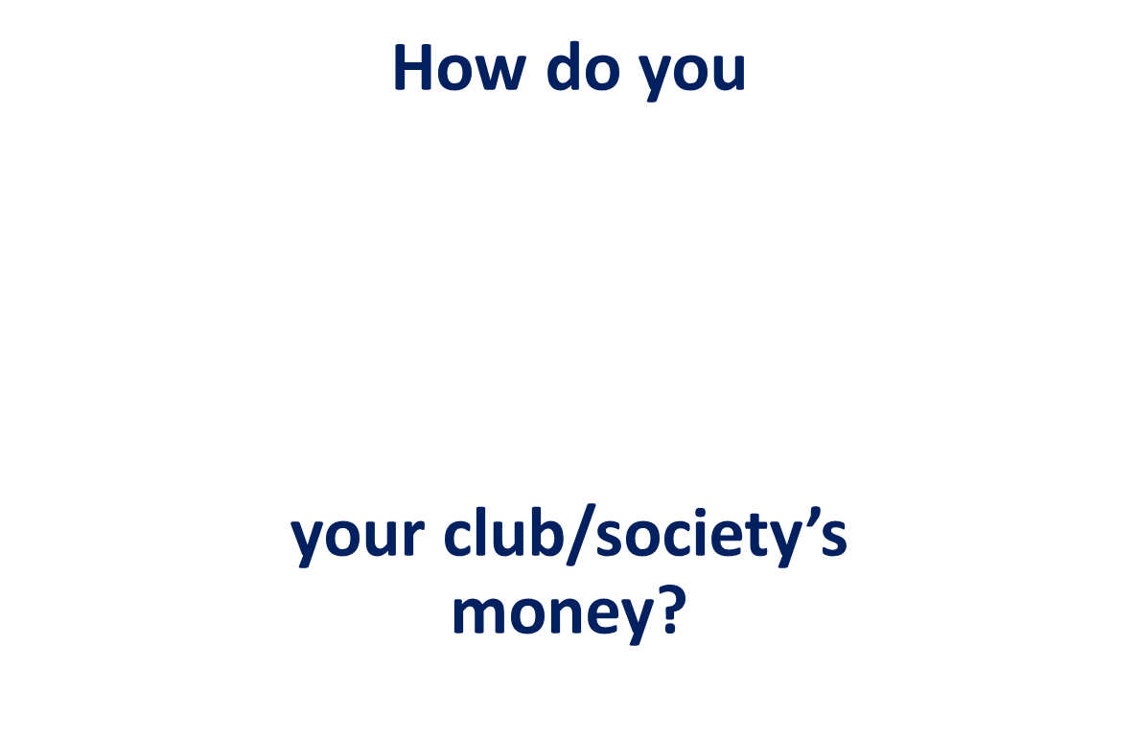

Good financial management is efficient and effective; it is critical to ensure your club/society is achieving its objectives and purpose.
Notes:
Ask the group ‘how do they think you should protect your charity’s money?’ and discuss
Objects and purposes laid out in constitutions
Discuss internal financial controls checklist handout. (sent out before course)

Slide 31
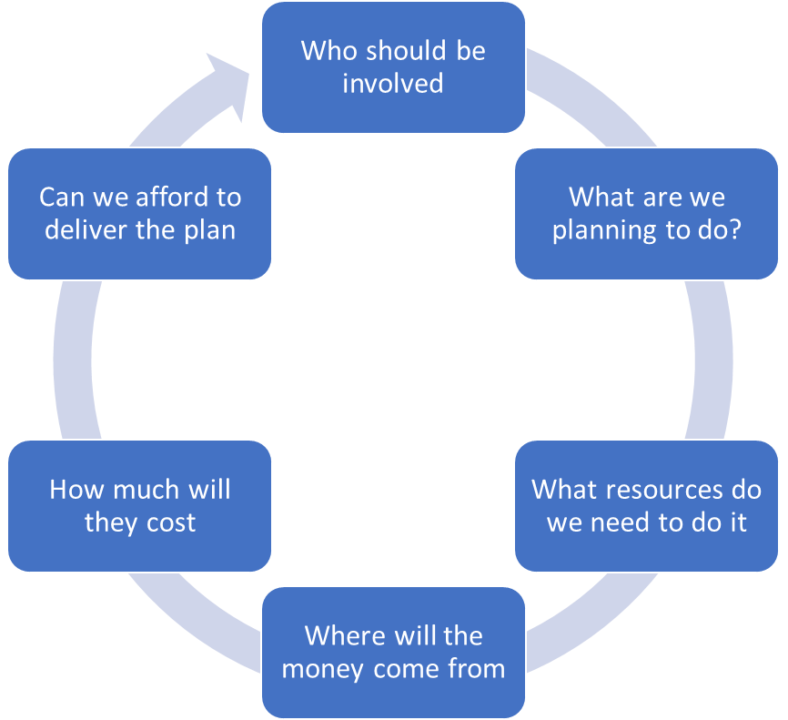
Setting a budget
You will need:
•Evidence
•Intelligence gathering
•Best guess
Notes:
Who should be involved?
Involve the people who actually do the work in creating the budgets.
To support your budget you will need:
Evidence – This year’s rent, salaries
Intelligence gathering – e.g. number of clients/beneficiaries you helped over the last year
Best guess – We see x number of clients at £10 each, which would cost us 10 times x or income from x number of members raises…….
You work round the loop and may need to revisit a few of the sections until the final answer is yes we can afford the plan.

Slide 32

SETTING A BUDGET FOR
AN EVENT
Venue hire
Village Hall - £25 per hour
Local Hotel - £250 for 5 hours
Additional equipment
PA system - £200
Food and refreshments
3 course meal - £35 per head Starter, main,
dessert tea and coffee
Buffet - £15 per head
Complement drink - £4 per head
Tea & Coffee - £3 per head
Entertainment
Speaker - £250
Singer - £300
Comedian - £500
Magician - £200
Notes:
During training session, do activity with group.
Participants complete the Budget Costings activity sent prior to training. Discussion of selections they made and how this impacted on their budget/event held and how much they charged for attendance was that a reasonable amount how could you amend the costs.
Fixed and variable costs. I.e. hall hire will be a fixed amount, catering will be variable a cost per head.

Slide 33
Events budgeting example
HASU Template Budget 25-26.xlsx

Slide 34
Why keep accurate records?
Records should show detail of transactions and be used to prepare accounts
Details of money received and spent by a club/society
The Club/society’s assets and liabilities
Accounting records should be kept for:
7 years
Make sure to label POs and invoices with specifics so we can track spending and income i.e. Transport, Kit, Dinner (nov) tickets, Dinner (nov) balloons.
Notes:
Remind students to always use the online finance tool for expenditure, ensuring receipts uploaded, what was purchased, providing as much detail as possible.
Please upload invoices that show expenditure including VAT, these can be found through website invoices (download section) and via the providers.
We expect our club and socs to keep a list of all equipment they own and where it is to avoid multiple purchases

Slide 35
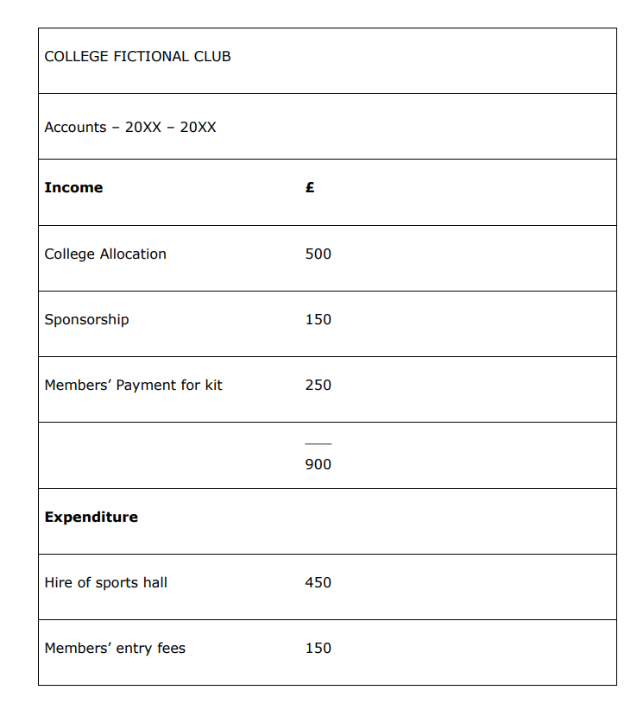
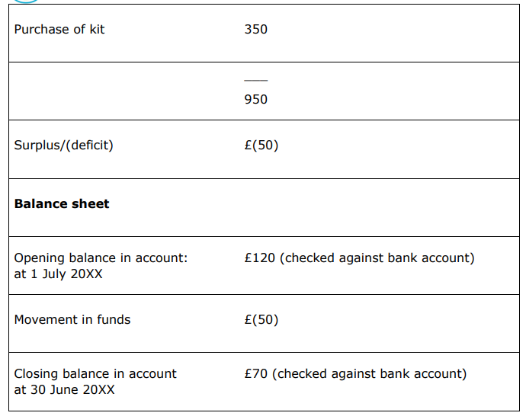
Example balance sheet
Notes:
By checking how much your club/society receives and spends against the budget, you can identify problems in good time and agree what to do about them. It’s particularly important to do this where you see big differences between the budget plans and what is actually being spent.
Getting funds – fundraising, selling goods and services.
Make sure you know the rules for getting funds in these ways and that you comply with them.
Membership price – justify why it is high or low. No membership price means very little funds. High membership price could put students off joining

Slide 36
Overall Account Balance
Monthly account balance updates via email.
Your overall balance can only be accessed by Activities or Finance.
The amount in your account should reflect what you want/ need to do as a club or society.
You should justify your membership price. Don’t make it too high or too low.
You should only approve spends that you know your group has money for.
If your funds go below £50 – all activity is frozen and we will meet you to discuss raising the funds.
If they go below 0 at the end of the year your group will fold.

Slide 37
Receiving Money?
Common income streams are:
Putting products and tickets up on the website – Visit Heather later to see how to do this!
Sponsorships
Donations
Memberships
Do you have any others?

Slide 38
Receiving Money?
Products on your SU Webpage are an easy way to receive small amounts of money – i.e donations
If your club or society is receiving money from a third party (e.g. through a grant or sponsorship), you will need to fill out an Invoice Request form so that Finance can generate an invoice for you to receive the payment.
This form must be filled out by your President/Chair or the Treasurer, and you must email a copy of your contract/proof of your agreement with the party you are receiving the money from.
Check all contracts with Activities first before signing.
Sponsorships – must fill in sponsorship form.

Slide 39
Sponsorships
Sponsorships are a common way of clubs and societies getting a bit of cash
Only consider sponsorships from companies that meet the values of the SU, they should also relate to the activity of your club/ society
We MUST check the contract
What barriers are there to you meeting your contract? IE, "Sailing Club must spend £1000 at the bar on socials before the £250 is awarded"

Slide 40

Fundraising
Your club/society can fundraise for charities
BUT
CANNOT make donations from its club/society funds (must be designated pot)
CANNOT make political donations
Every spend SHOULD be for the benefit of your club/society
members

Slide 41
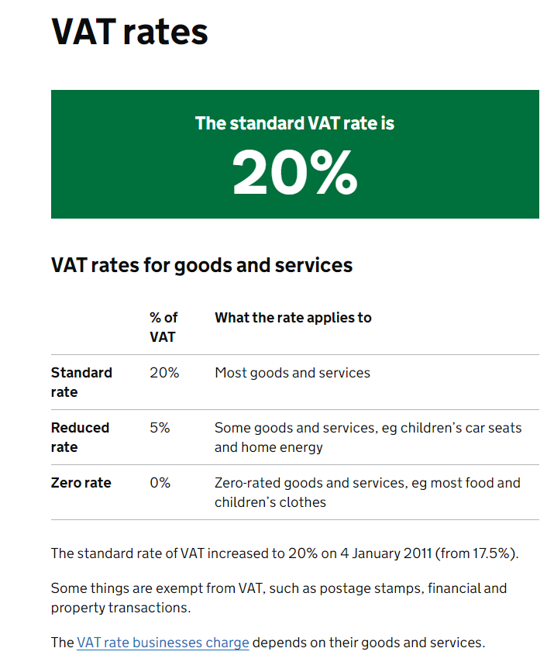
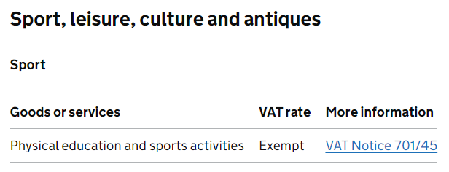
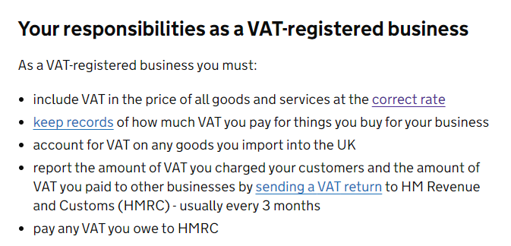
VAT – What is it and why pay it?
Notes:
https://www.gov.uk/guidance/rates-of-vat-on-different-goods-and-services

Slide 42
VAT – What is it and why pay it?
VAT is charged for most exchange of goods including sponsorships!
Difference between clubs and societies.
When to charge?
Selling merch or tickets?
- Yes
Sponsorships
– Yes
Donations to club/society
X - No
Any questions please ask Finance and they can inform you of the correct rate to charge.
Notes:
Clubs don’t have VAT charged on their memberships
Societies do!
Question – Do you think the gym has Vat applied to the memberships? YES! It is counted as a leisure activity so we charge VAT as per the legislation.

Slide 43
Common Dos and Don'ts
DON'T keep cash, this is technically theft
DON'T spend loads of your own money. For large payments, use invoicing or one of the credit cards
DON'T buy or use a card reader
DO add products to the website for small payments – ie “£1 Bake Sale”
DO check with Activities before committing to a big spend
DON’T set up sponsorships without checking with activities first
DON’T take any society payments into your own bank account – even if you intend to transfer it straight over, technically theft and a bit dodge

Slide 44
DEAL WITH FINANCIAL PROBLEMS QUICKLY
We want to avoid serious incidents and massive overspending!
Any questions or issues at any point come talk to Maisie or SJ
we are here to support you :)
Notes:
Examples of serious incidents
•fraud, theft or other significant loss
•a large donation from an unknown or unverified source
•links to terrorism or to any organisation that’s ‘proscribed’ due to terrorist activity
•a disqualified person acting as a trustee
•not having a policy to safeguard your club/society’s vulnerable beneficiaries
•not having ‘vetting’ procedures in place to check your prospective trustees, volunteers and staff are eligible
•suspicions, allegations or incidents of abuse of vulnerable beneficiaries
•
It is important that serious incidents are reported to the club/society Commission and declared in your Annual Return. If criminal activities is suspected you should also report these to the police.
If your club/society fails to report a serious incident, the club/society Commission may consider this to be mismanagement and take regulatory action. It is important that trustees ensure that their club/society reports any serious incidents to the club/society Commission.

Slide 45
Questions?

Slide 46

















AGENDA
Monday 22nd September
Morning Sessions
Student Leaders TRaining
09:00 -
Arrivals and Registration, tea, coffee, and biscuits
Weston Foyer, Weston building
09:30 -
10:00 -
Welcome, Introductions, Agenda, and what to expect from Training
Keynote Speaker - Amie Burke
Weston Lecture Theatre, Weston building
Weston Lecture Theatre, Weston building
10:30 -
Breakout Sessions 1
1.
Maximising Engagement through Marketing and Social Media
2.
Managing Group Finances
Trainer: Heather Dawson (Activities and Marketing Assist.)
Target: Social execs, Marketing/Social Media execs, Secretaries, any
Trainer: Maisie Glock (Activities Coordinator)
Target: Treasurers, Chairs, Vice Chairs, Any
Room: WF1
Room: Weston Lecture Theatre
11:20 -
Breakout Sessions 2
3.
Planning Activities and Fundraising
5.
Talking Club and Society Campaign Support
Trainer: Maisie Glock (Activities Coordinator)
Target: Chairs, Vice Chairs, Treasurers, Charity execs, Social execs, Any
Trainer: Daisy Douglas (SU President) , Erin Spruce (SU Vice-President
Target: Any
Room: Weston Lecture Theatre
Room: WG1
4.
Effective Admin and Using the Website
Quiet Room
Trainer: Heather Dawson (Activities and Marketing Assist.)
Target: Marketing/Social Media execs, Secretaries, Any
Reserved space for attendees needing a quiet break.
Room: WF1
Room: WF2
Notes:
The workshops focus is on these fundamentals:
The significance of listening, hearing, and reflecting.
Understanding extrinsic and intrinsic values.
The process of building on the best values for effective leadership.
Our workshops explore some foundational elements of leadership. We introduce practical training
strategies for understanding and aligning your intention, vision, values, and actions.
We start with listening and why it matters. We’ll then explore values and how they shape the quality of
our leadership character.

