Slide 1

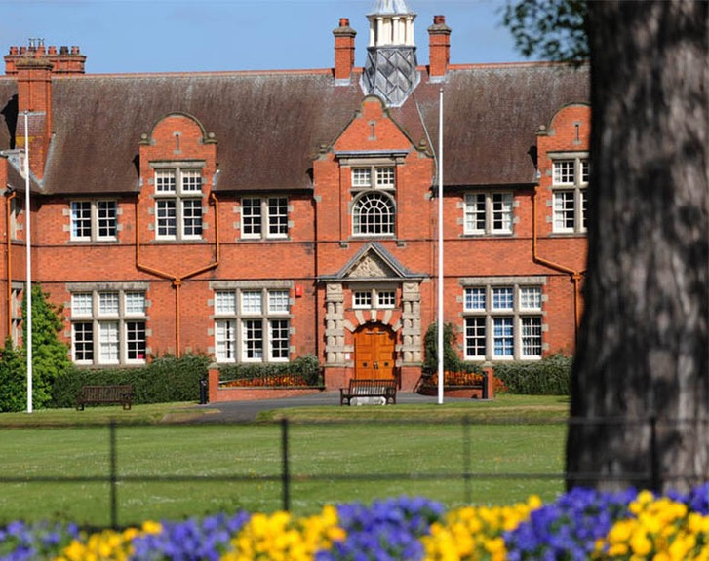


Effective Promotion and Securing Sponsorships
Your Students’ Union
Harpersu.com
Please make sure you have signed in at the desk in the Foyer.
Notes:
Thank you for attending.
Introductions from everyone in the room? Name, position, and club/soc
You might be thinking why are we here?
Want to continue the work that Ian started
You are all really important to the SU, and the University
All want successful clubs and socs – mental health, retention, student experience.
First step into getting us working together
We need to, to protect you – finances, H&S. Also legally as a Charity
We can help you develop your groups – budgets etc – more on that later

Slide 2

Logo Quiz
Complete the handouts – 10 mins
Notes:
14. Levi’s 15. DHL 16. Google Chrome 17. Toblerone 18. Waterford Crystal 19. IKEA 20. The North Face

Slide 3
Identify the brands
1. Aldi
2. Nando’s
3. Premier Inn
4. Airfix
5. Ralph Lauren
6. Lacoste
7. Ferrari
8. Wall’s (ice cream)
9. Toyota
10. B&M (B&M Bargains)
11. Specsavers
12. Monster Energy
13. Greggs
14. Levi’s
15. DHL
16. Google Chrome
17. Toblerone
18. Waterford Crystal
19. IKEA
20. The North Face
Notes:
14. Levi’s 15. DHL 16. Google Chrome 17. Toblerone 18. Waterford Crystal 19. IKEA 20. The North Face

Slide 4
Research
When looking for sponsors think...
What are your values as a group?
- Consider your aims and objectives
How do your values align with your sponsors?
- Look on their website for organisational values
- Research other universities clubs and societies and poach their sponsors
- What companies work closely with students?
- Are there any local businesses you can approach?
- Which companies target Gen-Z?
- Which companies offer student discounts?
- Look at Unidays, these companies target students!
Notes:
First thing is that although We work in partnership with the University,
we are independent, that means we are uniquely positioned to hold them to account and be that critical friend.
We can be the mouthpiece of you to get your views across to the Uni

Slide 5
Research
Look for sponsors who have similar values and interests as your club/society.
Make sure you check contracts with Activities for those who have contracts/requirements (e.g. ambassador, membership numbers, long term commitments).
Consider what you're offering of value:
Kit/Stash logo space
Advertisement on social media page
Sole provider of stash (monopoly of business)
What can they provide to you?
Kit/stash
Money
Equipment
Discount on activities, clothes, transport etc.

Slide 6
Research
Before you approach any sponsor ask yourself
Why would this business, brand, or corporation sponsor a harper student sports club or society/my group?
What is in it for them?
How does your club/society align with their brand, goals, values, sales, or community aims?
What can you offer beyond logos on clothing?
Think: of any opportunities but logo places on clothing, but make sure you can 100% deliver!
It is not the sponsors job to figure this out - it’s yours

Slide 7
Research
In pairs or 3s discuss the following: (pick one)
You are a big sports brand and are considering sponsoring a famous athlete
How does your brand benefit from a deal?
What would you want in the agreement?
You are a small local business and have been approached to sponsor a dinner for £1000
How would this affect your budget?
What could you offer instead of money?
Notes:
First thing is that although We work in partnership with the University,
we are independent, that means we are uniquely positioned to hold them to account and be that critical friend.
We can be the mouthpiece of you to get your views across to the Uni

Slide 8
Deal Secured?
Once you have secured a sponsor please ask them to fill in the form.
Send form over to suactivities@harper-adams.ac.uk
We will approve it and ask you to sign it
We will then sort an invoice out for money value and/or review contracts and give you the go ahead.
Any concerns or issues please get in contact with us!

Slide 9


Handbook

Slide 10
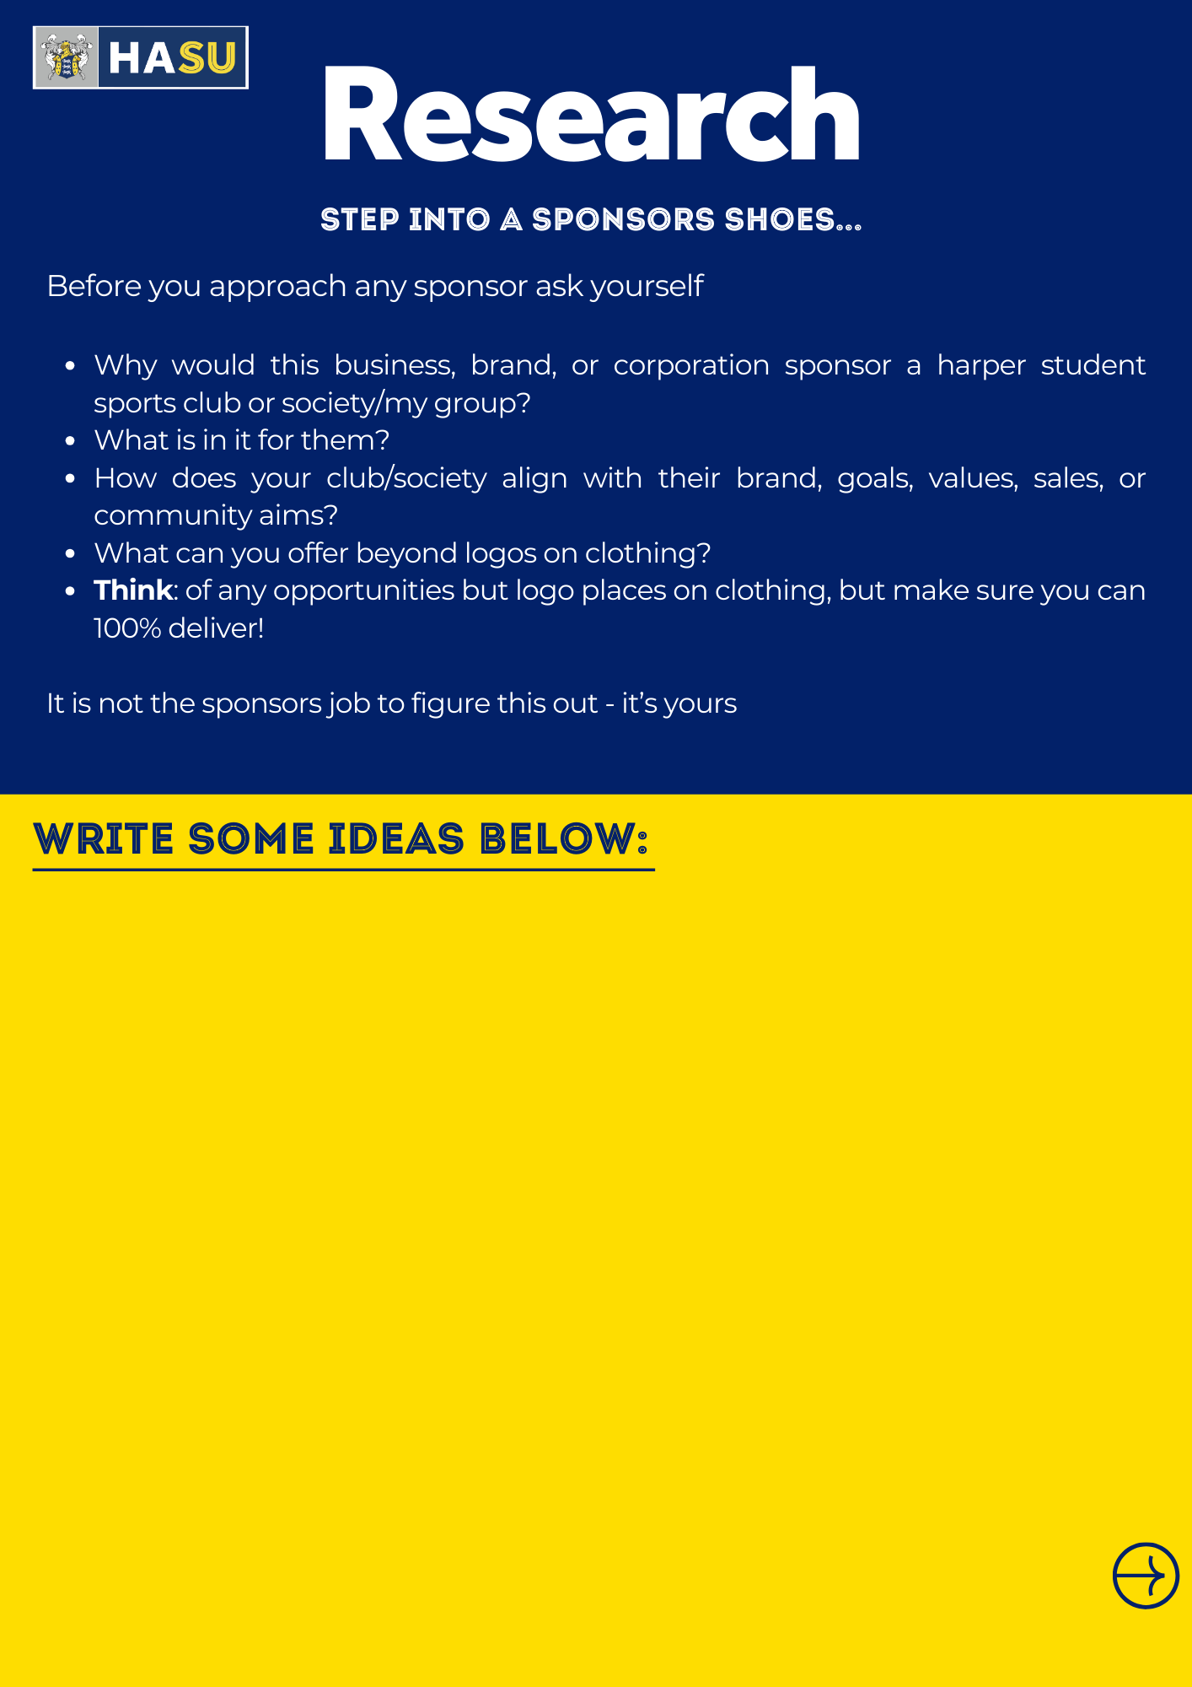

Handbook

Slide 11
Writing the
proposal
Notes:
14. Levi’s 15. DHL 16. Google Chrome 17. Toblerone 18. Waterford Crystal 19. IKEA 20. The North Face

Slide 12

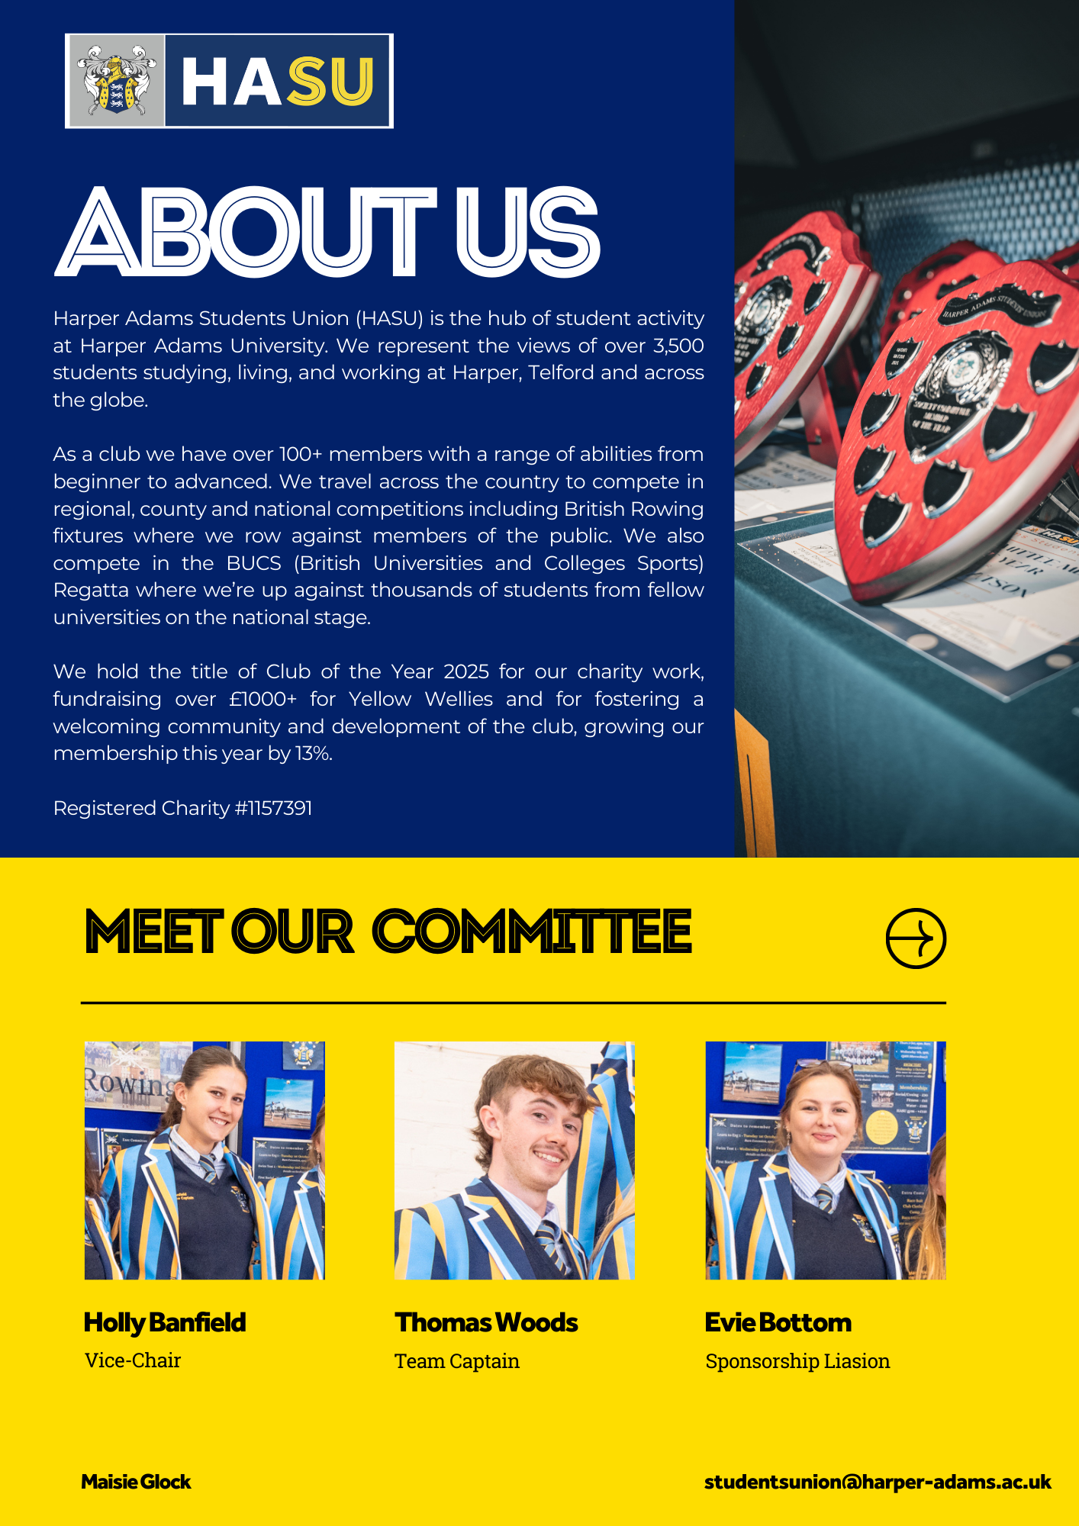
Handbook

Slide 13
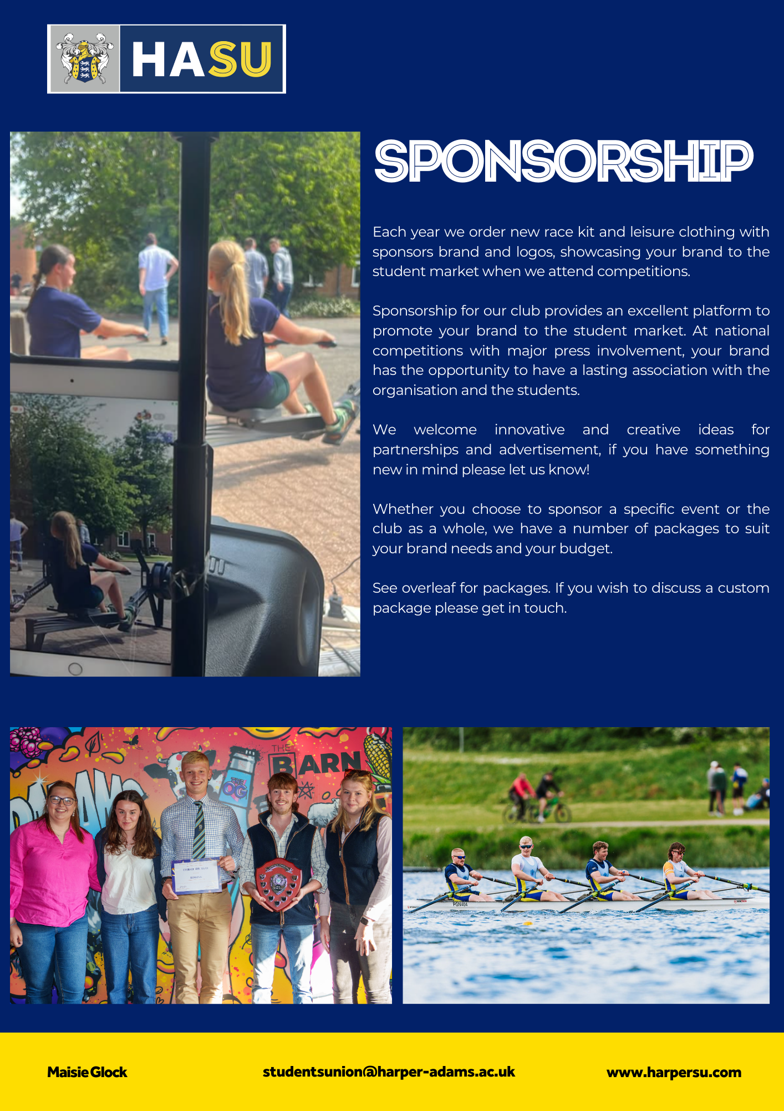
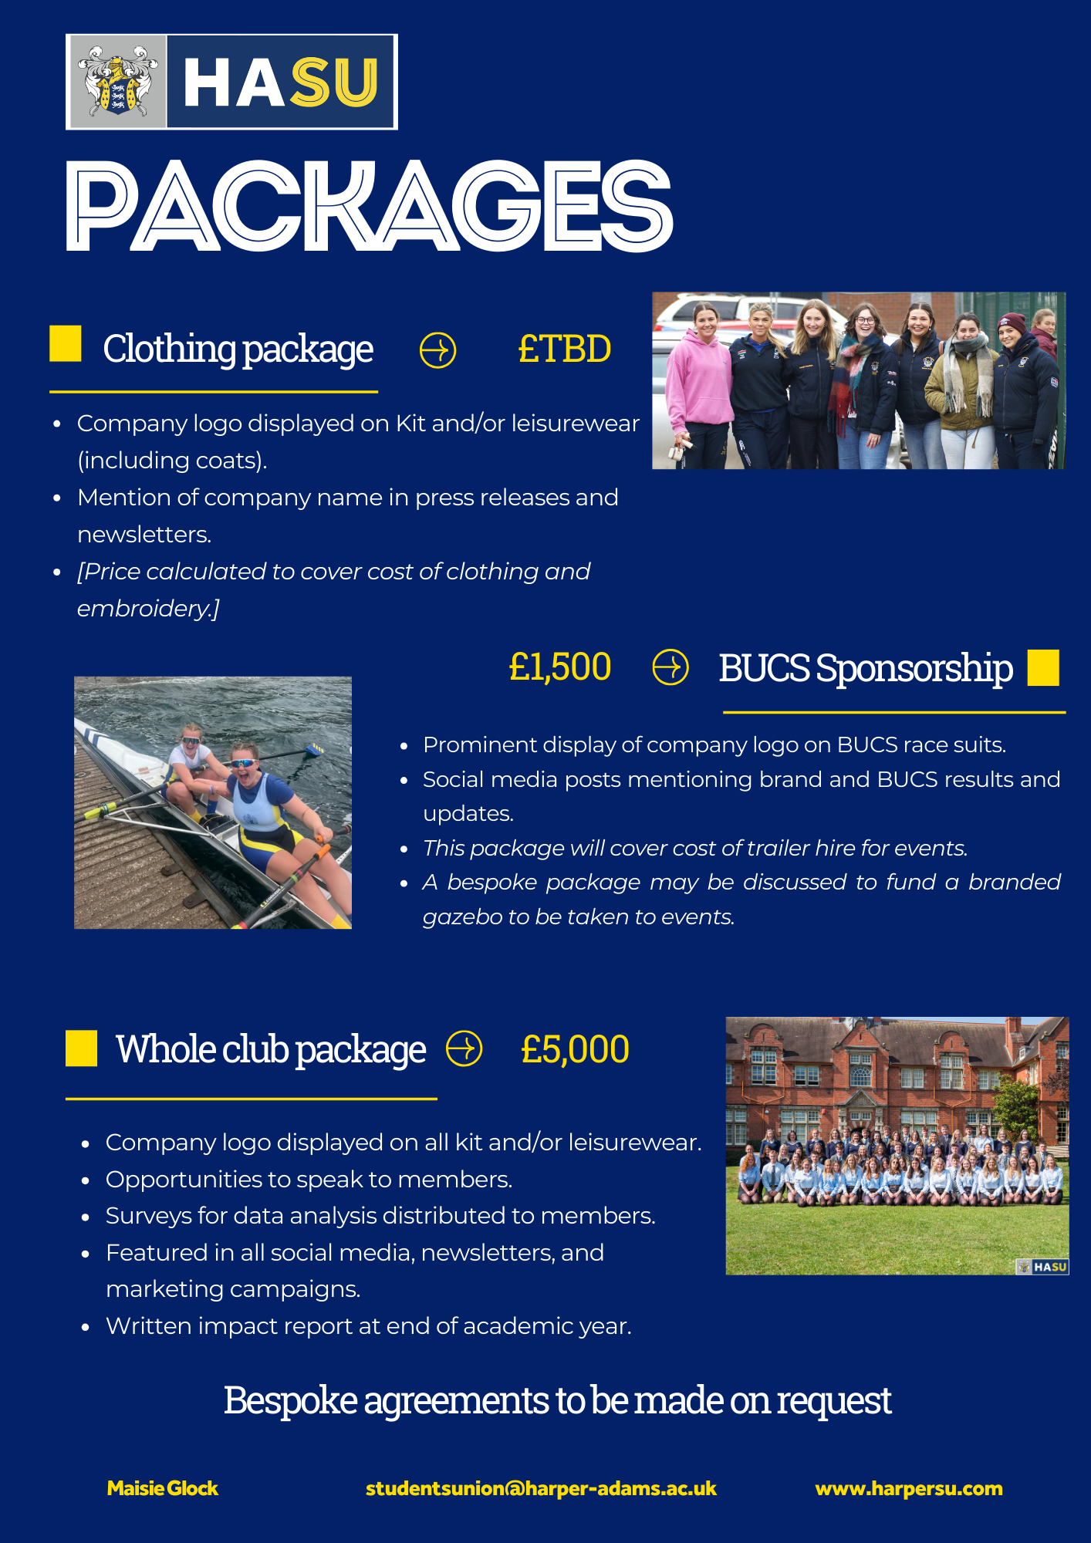
Handbook

Slide 14

Handbook

Slide 15
Tracking Sponsor
Progress

Slide 16
Check in
Company | Contact | Title | Contact Info | Last Contact | Notes
Prospect
Contact Made
Meeting
Proposal Submitted
Follow-up Meeting Booked
Confirmed
Declined
Notes:
Choose the right stakeholders.
No more than 10 check ins with one company (bit creepy).
Need to make each offer appealing every time, drip feed benefits of a meeting to them through each email/message.
Diverse contact points – linkedin, email, phone, different stakeholders.
Every contact, add relevance, motivation, make it more enticing and beneficial to them.
Contact multiple sponsors at the start – keep around 25 sponsors at the start line at any time.
> If one progresses to meeting, start process on another company.
‘No’ means not at this time, may be able to work with them in the future? Nurture this relationship.
Inform sponsors about nominations for awards, activities, to keep enticing them and keeping them interested.
Excel document to track the progress of sponsors.
Check-in after invoice sent, to ensure agreement is held up – lots falling through.
> Common pitfalls for clubs and societies?
> Delegate sponsorship responsibilities to one/two committee members and have them regularly check-in on progress.

Slide 17
Discuss
In pairs or 3s discuss the following:
Which brands have you seen sponsor HASU Clubs/Societies or Events in the past?
What is their motivation with HAU students?
What other brands could you target?
Optional: If you have secured a sponsor in the past:
What worked well?
What advice would you share without someone who has never secured a sponsor?
Notes:
First thing is that although We work in partnership with the University,
we are independent, that means we are uniquely positioned to hold them to account and be that critical friend.
We can be the mouthpiece of you to get your views across to the Uni

Slide 18
Questions?
Notes:
14. Levi’s 15. DHL 16. Google Chrome 17. Toblerone 18. Waterford Crystal 19. IKEA 20. The North Face

Slide 19














AGENDA
Tuesday 23rd September
Afternoon Sessions
Student Leaders TRaining
14:10 -
Planning Safe Socials
Students will be divided into groups and assigned space across breakout rooms.
Trainers: Maisie Glock (Activities Coordinator), Heather Dawson (Activities and Marketing Assistant), Michael Gale (Union Director),, Erin Spruce (Vice-President)
Various Rooms, Weston building
15:10 -
Breakout Sessions 2
4.
Recruitment, Retention and HASU Fair
5.
Transport Support
Quiet Room
Trainer: Heather Dawson (Activities and Marketing Asst.)
Target: Secretaries, BUCS Captains, Any
Reserved space for attendees needing a quiet break.
Trainer: Maisie Glock (Activities Coordr.)
Target: Charity execs, Social execs, any
Room: WG2
Room: Weston Lecture Theatre
Room: WF1
16:00 -
HASU Awards and Best Practice (Maisie Glock - Activities Coordinator)
Reflecting on Training and Going Forwards (Stephen and Julia)
16:30 -
Committee Training Finish.

