Slide 1

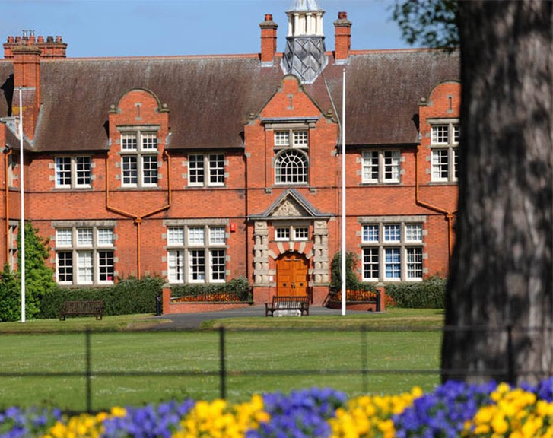


Planning Activities and Fundraising
Your Students’ Union
Harpersu.com
Take a seat!
Notes:
Thank you for attending.
Introductions from everyone in the room? Name, position, and club/soc
You might be thinking why are we here?
Want to continue the work that Ian started
You are all really important to the SU, and the University
All want successful clubs and socs – mental health, retention, student experience.
First step into getting us working together
We need to, to protect you – finances, H&S. Also legally as a Charity
We can help you develop your groups – budgets etc – more on that later

Slide 2
Discussion
In groups of 4 discuss….
What was the best club/society run activity you have attended?
(2 mins)
What makes a great training session or activity (whichever relevant to your role)
(5 mins)
Name some cheap or free activities you could run in your group
(2 mins)
Notes:
Introduce yourself to the person next to you, what are you doing, studying, preferred pronouns
Alternative Ice Breaker
To spice up the question; a puppy, your best friend, your partner, your nan etc
What’s the most important thing you’ve learned about money to date?

Slide 3
Planning and Delivering
From training, to speakers and other activities

Slide 4
Plan
What is the purpose of the activity?
Casual friendship building
Skills building
Networking with professionals
Who will be coming?
Members, non-members, alumni, spectators
Is there an extra cost to the activity? Make it accessible to all members
Will you need tickets put up on the website? Merch?
Want to spend club/society money – think about POs!
Ask your members what they want!
Notes:
Who will be attending?
Members? Non-members? Alumni? Guests? Spectators? U18's? Attendees with accessibility requirements?
Where will it be?
When will it be?
How many people?
Do you require transport, food, alcohol, bad weather contingencies, venue deposits?
Will cost to members be reasonable while still covering the cost of the event?
Will you have external speakers?
You can use the event planner for smaller events if it helps

Slide 5
Action
Is it outside normal activities? – Complete a Risk Assessment
Want to use Club/Soc money – Ask treasurer to check budget + Submit a PO
Talk to your coaches/instructors about sessions in advance.
Need tickets putting up on website – advance notice and dates for online/offline
Booking deadlines?
Members driving each other? Self-driving form
Need to use somewhere on-campus? Check availability + book in advance – suactivities@harper-adams.ac.uk
External Speaker Form – 14 days notice
Notes:
Who will be attending?
Members? Non-members? Alumni? Guests? Spectators? U18's? Attendees with accessibility requirements?
Where will it be?
When will it be?
How many people?
Do you require transport, food, alcohol, bad weather contingencies, venue deposits?
Will cost to members be reasonable while still covering the cost of the event?
Will you have external speakers?
You can use the event planner for smaller events if it helps

Slide 6
Action
Advertise on socials – tag HASU!
Check marketing session for tips and advice
Submit the risk assessments – get them checked
Complete any training necessary
Order the equipment/confirm the booking
Submit invoices
Back-up plans and wet weather alternatives

Slide 7
Deliver
Check supplies, agenda, operational plans
Be flexible on the day
Take head counts
Get feedback
Debrief after activity – what went well? Better for next time?

Slide 8
Some suggestions…
Activity Ideas:
External speaker events
Trips to sponsor companies
International sports tours e.g Volleyball tours, Ski trips
Paint (and Sip)
Laser Tag
Bowling
Ice Skating
Paintball
Casual sports – tag rugby, badminton, rounders
Fancy dress sports day
Themed sober socials (as well as socials)
Watch parties – 6 Nations, FA World Cup etc
Try out another club – compete
Volunteer at another charity
Treasure hunts
Board game evenings
Academic support sessions
Exam group study sessions
Quizzes
Wellness evenings/spa nights
Escape Rooms
Murder mystery
Online games
Open Mic nights
Game shows
Create a Podcast
Notes:
And more…
Collab playlists for training or activities
Coffee mornings
Crafts
Put on a big event
Sports Tournaments
Fundraising events
Visit a zoo
Lip Sync Battle
Cook/Bake-Off
University challenge
Kahoot
Panel discussion
Careers event
Skills workshops
Technical classes

Slide 9
Risk in Activities
Legal obligations to stay safe

Slide 10

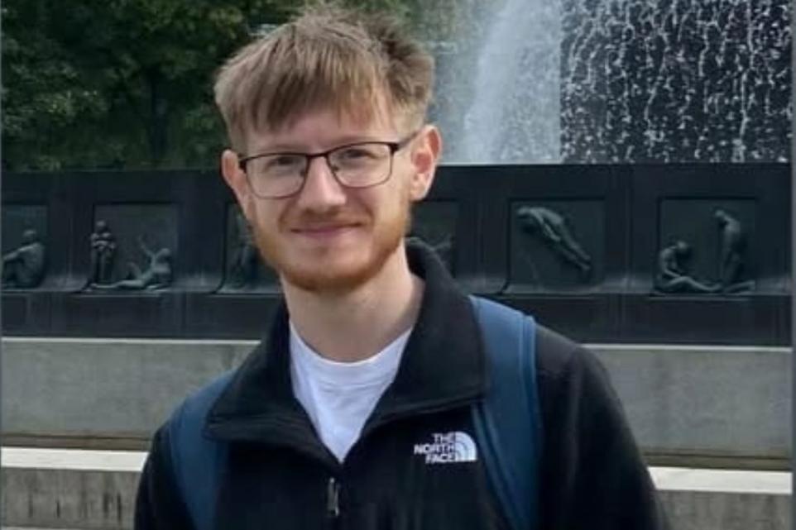
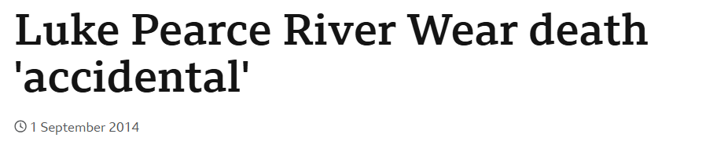
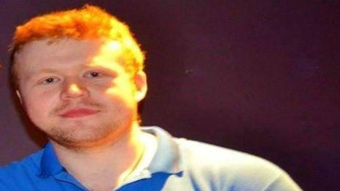

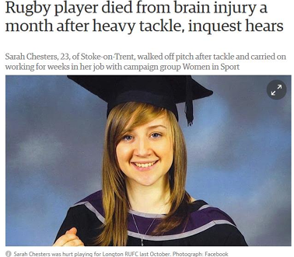
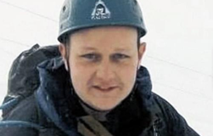
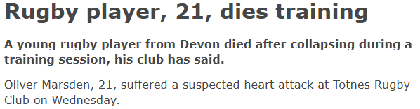

Why is it important?

Slide 11
Keeping you Safe
You cannot be 100% Safe
Mitigations
Physical and Mental Safety
Concussions, drowning, alcohol/drink driving, slips and trips most common deaths and injuries

Slide 12
Consider – what risks are involved
What can cause students harm
Financial risk
Research already made assessments you can use
What about the following items?
Money behind the bar for socials drinks?
Sunglasses for members?
Sports kits for 1st team?
Painting supplies for society activity?
Donating leftover income from a Dinner Dance?

Slide 13
Insurance
Notes:
Freedom of Speech
Equality Act
GDPR
SafeGuarding
Health and Safety
Regulatory frameworks
Financial legislation and law
HE legislation

Slide 14
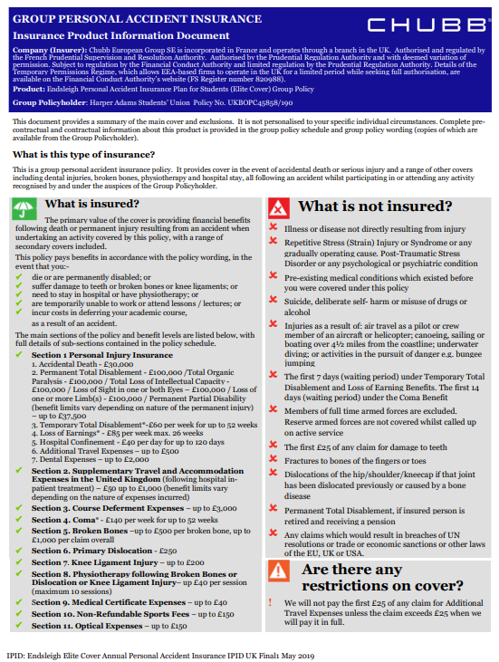
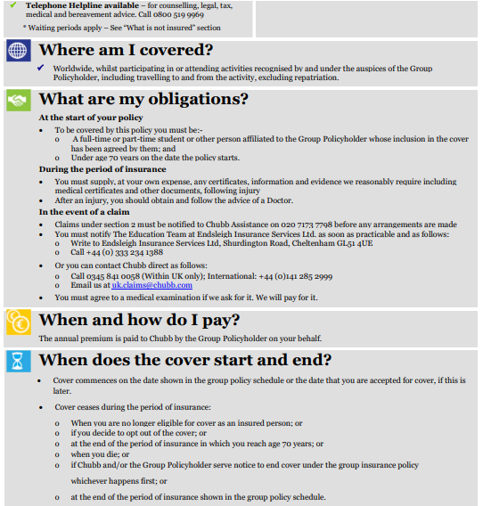
HASU insurance

Slide 15
Insurance + First Aid
Is your activity covered?
Do you need extra insurance? - Mandatory for participants vs recommended
Are there affiliate organisations that require additional insurance?
Are you insured through your external affiliations? E.g MSUK
Are there first aid staff requirements?
Do you need paramedics or an ambulance? - Check event requirements or NGB/affiliate requirements (BUCS, WR, FA etc)
Have you given enough notice to book staff and get insurance?
Don't leave it last minute!

Slide 16
Security and external sellers
Do you want food/merchandise sellers there?
How much are you charging them to attend?
Has it been risk assessed?
Where are they pitching? (car park closures?)
Do they need power or gas?
Do they have insurance, food hygiene qualifications, a business food safety rating of 3+ (pass)?
Do you want alcohol selling?
Security needs booking
Ask Venues to open welly/barn or hire bar trailer
Is the event ticketed?
If outside - does it need to be fenced off?
Who's checking tickets? etc

Slide 17
Fundraising
Notes:
Freedom of Speech
Equality Act
GDPR
SafeGuarding
Health and Safety
Regulatory frameworks
Financial legislation and law
HE legislation

Slide 18

Fundraising
Your club/society can fundraise for charities
BUT
CANNOT make donations from its club/society funds (must be designated pot)
CANNOT make political donations
Every spend SHOULD be for the benefit of your club/society
members

Slide 19
A bit of background…
HASU is a charity AND a Students Union which means…
Legal obligations
Charity Law
Education Act
In pairs:
What are some other laws that affect SU’s,
Clubs, and Societies?
Notes:
Freedom of Speech
Equality Act
GDPR
SafeGuarding
Health and Safety
Regulatory frameworks
Financial legislation and law
HE legislation

Slide 20

The Education Act 1994
Allocation of group funds
(i)the procedure for allocating resources to groups or clubs should be fair and should be set down in writing and freely accessible to all students;
Defines the meaning of SU’s
Part II 22 (i,) refers to resource allocation for groups and clubs
Part II 22 (j-l) refers to external affiliations
Notes:
Defines the meaning of a students’ Union. Particularly relevant sections are:

Slide 21
The Education Act 1994
The relevant parts for Activities:
What is a students' union?
How students are members (and how they opt out)
Allocation of resources to student groups
Affiliations and subscriptions to external groups/bodies
Notes:
Defines the meaning of a students’ Union. Particularly relevant sections are:

Slide 22

The Charities Act 2011
SU’s acceptable purposes is “the advancement of education of students”.
The objects of the union are advancement of education of students at [university name] for the public benefit by:
Promoting the interests and welfare at [Harper Adams] during their course of study and representing, supporting and advising students;
Being the recognised representative channel between students and [Harper adams] and any other external bodies; and
Providing social, cultural, sporting and recreational activities and forums for discussions and debate for the personal development of its students.
Notes:
Interests and welfare - can relate to student fundraising, as well as campaigns.
Social cultural and recreational activities - Clubs and socs, sports etc.
Forums for discussions and debate - AGM's, student media, debate clubs/society.
Voice - Represent
Support - All departments and staff
Advising - We do not have an advice centre like a lot of SU's.
Personal development - committee positions and training,

Slide 23
Relevance to Club and Society Finances
ULTRA VIRES
What does it mean?
A – Beyond the Powers
C – Education Only
B – Charity Embezzling
Notes:
Freedom of Speech
Equality Act
GDPR
SafeGuarding
Health and Safety
Regulatory frameworks
Financial legislation and law
HE legislation

Slide 24
Relevance to Club and Society Finances
ULTRA VIRES
What does it mean?
A – Beyond the Powers
C – Education Only
B – Charity Embezzling
Notes:
What does Ultra Vires mean?
Education only, Beyond the powers or ultimate virus?
As charities, student unions must take care to avoid Ultra Vires meaning "beyond the powers". A charity can't engage in activities that do not support their charitable purposes.
The purpose of student fundraising is the advancement of education (developing the students involved) It really is the taking part that counts! Some of the purpose also meets the interest and welfare of students while they study.

Slide 25
Ultra Vires
Clubs and societies are at a high risk of contravening UV...
All fundraising events should be organised by students for students.
Advance decisions with clear allocation of money.
Fundraising for other charities should clearly state the beneficiary (the targeted charity).
SU funding cannot be transferred to other charities.
SU’s and students shouldn’t underwrite RAG/fundraising losses.
Clubs and societies cannot use membership funds and leftover monies to donate to external charities.
We will go more in-depth in my next session: Planning Activities and Fundraising
Notes:
Education only, Beyond the powers or ultimate virus?
As charities, student unions must take care to avoid Ultra Vires meaning "beyond the powers". A charity can't engage in activities that do not support their charitable purposes.
The purpose of student fundraising is the advancement of education (developing the students involved) It really is the taking part that counts! Some of the purpose also meets the interest and welfare of students

Slide 26

Scenario
10 mins
In groups of 4 discuss the scenario and questions below…
The fashion society organises a clothes swap event where students bring items to swap. There’s also an option to make a donation to buy items.
The event is popular and the society makes a £350 profit.
The committee decided at their meeting after the event to donate £300 of the profit to the local homeless charity.
How does it contravene ‘ultra vires’?
What improvements can you make to make it acceptable considering UV?
Notes:
Unclear where the donations are headed from the start. As it isn't made apparent, the default is to assume the donations are intended for the society.
This means the society has donated funds intended for their members and charitable objectives to another external charity, going beyond their powers.
If they advertised the funds were intended for the local charity, they should donate the whole funds rather than part of them.
Solutions: advertise at the fundraiser where funds are designated and ensure that the funds go where intended. If it is a portion of the funds go to each then they need to show that too.

Slide 27
Steps to keep fundraising legal
Name the charity you're fundraising for at the start
Advertise on tickets AND event page/social media who you are fundraising for
If donating ticket money – name the portion you will be donating when advertising the event (£5 from ticket income, 10% of all profit from event etc)
If donating event funds to multiple charities
Name charities and portions of funds donating when advertising/fundraising.
Don't donate to political charities
Budget event so all running costs are covered by amount raised – portion or entire profit is donated.
Notes:
All costs for your event must be covered by the amount raised and then a portion or the entirety of the profits can be donated to your agreed charity. Club/Society funds cannot be used for any expenses relating to a charity event.
If you are hosting a ticketed charity event, or a ticketed event with a charity aspect (e.g. a ball with a charity raffle), the standard events process must be followed. For the standard events process, please see the relevant events page
If your event is not ticketed, then you can liaise directly with the charity of your choice to make your donation.
We’d love to hear about your fundraising activities!!! Let us know how much you raised here:

Slide 28
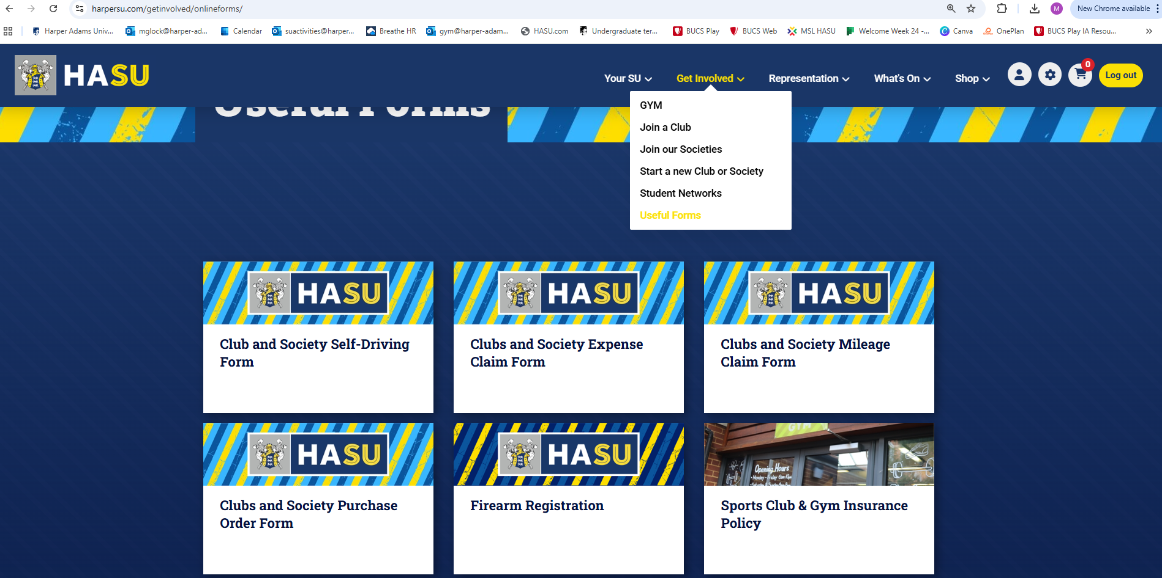
Where to find the forms
Notes:
You can find our online Expense and PO forms on the website under Get Involved – Useful Forms
Currently building a committee resource page with help guides, forms, and other resources

Slide 29
Questions?

Slide 30















AGENDA
Monday 22nd September
Afternoon Sessions
Student Leaders TRaining
12:00 -
Lunch
Weston Foyer, Weston building
13:00 -
Developing Student Leaders Workshop - Part 1
Various activities on Listening Matters building on foundational elements on Leadership.
Activities will cover rest of day.
Students will be divided into groups and assigned space across breakout rooms.
Day 2 will begins with part 2 of workshop.
Workshops led by Stephen and Julia (external)
Weston Lecture Theatre, Weston building | Other locations to be announced
16:00 -
Day 1 Finish.

