Slide 1

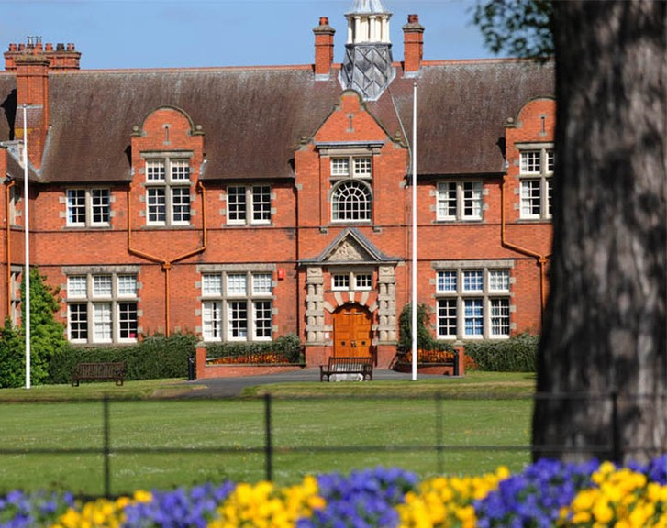


Planning Safe Socials
Your Students’ Union
Harpersu.com
Take a seat!
Notes:
Thank you for attending.
Introductions from everyone in the room? Name, position, and club/soc
You might be thinking why are we here?
Want to continue the work that Ian started
You are all really important to the SU, and the University
All want successful clubs and socs – mental health, retention, student experience.
First step into getting us working together
We need to, to protect you – finances, H&S. Also legally as a Charity
We can help you develop your groups – budgets etc – more on that later

Slide 2
Before we start
Ground rules:
This is a judgment-free safe space to ask questions and explore themes and behaviours.
We will be discussing sensitive topics – please look after yourself
Be honest (including staff)
Remember – we are here to support you
Notes:
10 mins

Slide 3
Make a group of 4
Discuss the following questions:
What was your favourite social you have attended?
What made it your favourite?
What worries do you have about running socials?
Notes:
10 mins

Slide 4
Scenario:
You have a student who wants to join the group but they are apprehensive. They have heard about the groups' socials and are worried about drinking and initiations.
In your 4 discuss...
How has the culture of initiations already impacted your club?

Slide 5
What do you think HASU and the University's number 1 priority is when it comes to socials?

Slide 6
HASU Priorities
Educating social execs and committee on the boundary of acceptable behaviour
Supporting students to run fun events and socials that meet their aims.
Keep students safe - mentally and physically
Mitigate harm
Support groups to stay out of grey areas and have smooth running socials without fear of backlash.
Build trust with groups – we are here to support you with this!

Slide 7
Initiations
Any activities expected of someone joining or participating in a group that humiliate, degrades, abuses, or endagers them, regardless of a persons willingness to participate
The activity does not need to have cause physical or emotional harm, risk of harm will suffice
The activity does not need to be defined for the purposes of disciplinary offence. It would be an activity easily recognisable as such by any person of reasonable firmness present at the scene. There is no requirement for a person of reasonable firmness to be, or likely to be physically present.
Notes:
Initiation ceremonies are defined as being events in which members (often, though not exclusively, new members) of a Club or Society are expected to perform a task or tasks as a means of gaining acceptance, status or credibility within the Club or Society. This may involve peer pressure (though not explicitly) exerted on students, and may compromise a person’s inherent dignity as a person by forcing or requiring an individual to drink alcohol, eat mixtures of various food stuffs, nudity and behaviour that may be deemed humiliating. Social event’s must not become ‘initiations’ or be classed as ‘welcome drinks’
Any activities expected of someone joining or participating in a group that humiliate, degrades, abuses, or endagers them, reagrdless of a persons willingness to participate
The activity does not need to have cause physical or emotional harm, risk of harm will suffice
The activity does not need to be definied for the purposes of disciplinary offence. It would be an acitivity easily recognisable as such by any person of reasonable firmness present at the scene. There is no requirement for a person of reasonable firmess to be, or likely to be physically present.

Slide 8
Other hazing behaviours
Lashings
Any physical or sexual act against another (e.g. Hair shaving)
Forced Nudity
Forced vomiting
Defecating and Urinating on yourself or others
Forced drinking (alcohol and other material)
Spraying with stock marker
Different rules or uniforms for freshers e.g. marking their face with an 'F'
Notes:
Lashings with belts
Punishment pints of alcohol, vomit, urine ,poo, mud, mixtures of stuff
Physical or sexual act against another
Forcing members to their knees

Slide 9
Keeping you Safe
You cannot be 100% Safe – but get as close as possible
Mitigations and safeguarding
Physical and Mental Safety
Concussions, drowning, alcohol/drink driving, slips and trips most common deaths and injuries
Plan to get members to and from Newport for socials

Slide 10
Risk in Activities
Legal obligations to stay safe

Slide 11
Consider – what risks are involved
Same as any event – risk assess it! (guidance on Activities and Fundraising slides)
What are the hazards?
What can go wrong?
How can you pro-actively stop it going wrong? - Active Bystander
What can you do to minimize the impact if still goes wrong?
Notes:
Although this is not an exhaustive list, examples of initiation/hazing activities can include:
Pressure, whether tacit or explicit, to consume alcohol, drugs or obnoxious substances, in excessive quantities
Organised activities that are dangerous, unlawful in any way, or involve humiliating people (includes pressure,
whether tacit or explicit, to be publicly naked/semi naked)
Acts perpetrated against a person’s body (e.g. shaving hair/eyebrows)
Psychologically and/or physically tormenting people (e.g. locking them in darkened rooms, playing disturbing
noises, etc)
Sexual assault, harassment or misconduct
Victimisation, where a group of students (e.g. 1st years, the 3rd team) are targeted for any of the above activities
Pressure, whether tacit or explicit, to buy anything (e.g. equipment, clothes, food, drinks) or attend social activities
that is excessive and results in financial hardship.
The University and SU define initiation or hazing activities as any activity or behaviour which:
Is expected of someone joining or participating in a group that humiliates, degrades, abuses or endangers them,
regardless of their willingness to participate.
Involves taking improper advantage of another person as a result of a power imbalance or position within a club,
society or organisation
Involves tacit or explicit improper coercion or manipulation of students to their physical or mental detriment, or
which compromises their human dignity.

Slide 12
Report and Support
Something has happened – what do I do?!
Immediate risk of harm or danger to others - 999
Daytime support that's NOT 999 - Student Services +44 (0)1952 815396
Support out of hours, contact the Health Assured helpline 24/7: 0800 028 3766
Security 24/7 on 07980 061128.
External Charities that can help:
Mind (9am to 6pm, mon-fri) - 0300 102 1234.
Samaritans (24hrs, 365 days) - 116 123 or 0808 164 0123 (Welsh)
National Suicide Prevention Helpline (6pm to midnight) - 0800 689 5652
https://liveharperac.sharepoint.com/sites/HealthWellbeing/
Report to university - https://www.harper-adams.ac.uk/about/764/our-inclusive-university/
Report to us – https://www.harpersu.com/getinvolved/onlineforms/sucomplaints/
Report initiations to BUCS - https://www.bucs.org.uk/report-an-initiation.html
Notes:
https://www.bbc.co.uk/news/articles/ckg1n54v60jo

Slide 13
Workshop

Slide 14
Create a group of 4
Try to find students from other clubs and societies
Find a mix of roles
When you have your team nominate 1 student to be your ‘Social Exec’
Notes:
Introduce yourself to the person next to you, what are you doing, studying, preferred pronouns
Alternative Ice Breaker
To spice up the question; a puppy, your best friend, your partner, your nan etc
What’s the most important thing you’ve learned about money to date?

Slide 15
Task
Plan a 5 minute social for a group of students who have never met.
Think about the following:
What do you want members to get out of your social?
2. What activities can you run to achieve that?
Remember your values from earlier!
Notes:
Tips – Wellbeing officer/Chair act as observer – can intervene if things get too far and watch the responses from members.

Slide 16
Plan
Traditions:
If you have traditions/legacy activities at socials - how can you shape them to make them safe for all members while meeting your aims?
Notes:
Who will be attending?
Members? Non-members? Alumni? Guests? Spectators? U18's? Attendees with accessibility requirements?
Where will it be?
When will it be?
How many people?
Do you require transport, food, alcohol, bad weather contingencies, venue deposits?
Will cost to members be reasonable while still covering the cost of the event?
Will you have external speakers?
You can use the event planner for smaller events if it helps

Slide 17
Action
Show us what a great social looks like!
Notes:
Who will be attending?
Members? Non-members? Alumni? Guests? Spectators? U18's? Attendees with accessibility requirements?
Where will it be?
When will it be?
How many people?
Do you require transport, food, alcohol, bad weather contingencies, venue deposits?
Will cost to members be reasonable while still covering the cost of the event?
Will you have external speakers?
You can use the event planner for smaller events if it helps

Slide 18
Action
Is it outside your normal social activities? – Complete a risk assessment
Check is it appropriate? – use commons sense and if you’re not sure just ask Maisie!
Run it by your members with an anonymous survey – get feedback!
Don’t have punishments for lateness, earlyness, or making a mistake – nice to people = retention and engagement!
Notes:
Who will be attending?
Members? Non-members? Alumni? Guests? Spectators? U18's? Attendees with accessibility requirements?
Where will it be?
When will it be?
How many people?
Do you require transport, food, alcohol, bad weather contingencies, venue deposits?
Will cost to members be reasonable while still covering the cost of the event?
Will you have external speakers?
You can use the event planner for smaller events if it helps

Slide 19
Deliver
Check supplies
Be flexible on the day
Take head counts
Get feedback
Debrief after activity – what went well? Better for next time?

Slide 20
Some suggestions…
Sober or Alternative Social Ideas:
Pub trip after training – 1 or 2 casual pints
Paint (and Sip)
Laser Tag
Bowling
Ice Skating
Paintball
Casual sports – tag rugby, badminton, rounders
Fancy dress sports day
Scavenger hunts – check itinerary is appropriate!
Watch parties – 6 Nations, FA World Cup etc
Board game evenings
Quizzes
Wellness evenings/spa nights
Escape Rooms
Murder mystery
Online games
Open Mic nights
Game shows
Create a Podcast
Notes:
And more…
Collab playlists for training or activities
Coffee mornings
Crafts
Put on a big event
Sports Tournaments
Fundraising events
Visit a zoo
Lip Sync Battle
Cook/Bake-Off
University challenge
Kahoot
Panel discussion
Careers event
Skills workshops
Technical classes

Slide 21

Your Responsibilities
As a committee member and group leader
Run activities that are appropriate
Create a culture of kindness, communication, and respect for fellow students
Listen to your members – as much as you lead them, they should lead you.
Reach out if things go wrong or you aren't sure if it's an acceptable activity.
Set a positive and good example as a role model for other students.
Keep students safe during activities!
Notes:
First thing is that although We work in partnership with the University,
we are independent, that means we are uniquely positioned to hold them to account and be that critical friend.
We can be the mouthpiece of you to get your views across to the Uni

Slide 22
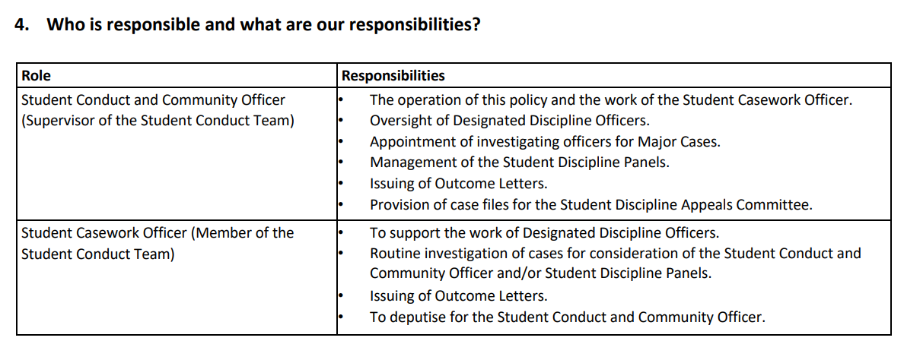
University Responsibilities
Student Conduct and Discipline
Notes:
First thing is that although We work in partnership with the University,
we are independent, that means we are uniquely positioned to hold them to account and be that critical friend.
We can be the mouthpiece of you to get your views across to the Uni

Slide 23
HASU Responsibilities
Educate committee members and leaders to understand the boundaries of acceptable behaviour.
Give committee members the skills to run socials that are fun and create bonds between students that are safeguarding all participants (including execs!)
Support clubs and societies to plan activities through social development meetings and check risk assessments.
Activities Coordinator
Support Club and Societies going through university and Union disciplinary processes – advocate for the students when appropriate.
Be open-minded and non-judgmental when students approach regarding socials ideas.
Union Director
Manage union complaints and investigate disciplinary cases assigned to the SU by the University
Notes:
First thing is that although We work in partnership with the University,
we are independent, that means we are uniquely positioned to hold them to account and be that critical friend.
We can be the mouthpiece of you to get your views across to the Uni

Slide 24
Questions?

Slide 25














AGENDA
Tuesday 23rd September
Afternoon Sessions
Student Leaders TRaining
14:10 -
Planning Safe Socials
Students will be divided into groups and assigned space across breakout rooms.
Trainers: Maisie Glock (Activities Coordinator), Heather Dawson (Activities and Marketing Assistant), Michael Gale (Union Director),, Erin Spruce (Vice-President)
Various Rooms, Weston building
15:10 -
Breakout Sessions 2
4.
Recruitment, Retention and HASU Fair
5.
Transport Support
Quiet Room
Trainer: Heather Dawson (Activities and Marketing Asst.)
Target: Secretaries, BUCS Captains, Any
Reserved space for attendees needing a quiet break.
Trainer: Maisie Glock (Activities Coordr.)
Target: Charity execs, Social execs, any
Room: WG2
Room: Weston Lecture Theatre
Room: WF1
16:00 -
HASU Awards and Best Practice (Maisie Glock - Activities Coordinator)
Reflecting on Training and Going Forwards (Stephen and Julia)
16:30 -
Committee Training Finish.

